Slide 1
    Truly Open Augmented Reality
    Where 2.0
    San Jose California
    March 31, 2010
  Mike Liebhold – Institute for the Future
  Shailesh Nalawadi - Google
  Carl Reed - OGC Open Geospatial Consortium
  Damon Hernandez - Web 3D
  Sophia Parafina – OpenGeo
©2010 Institute for the Future All rights reserved. All other brands and trademarks are the property of their respective owners. Reproduction prohibited without written permission.

Slide 2
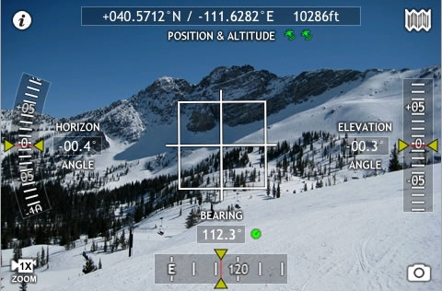
The viewfinder is the new browser
thodelite

Slide 3
AR = Geodata in the real world
Update: KML content 11/09
  250,000 public websites hosting KML
  500,000,000 publicly hosted KML/KMZ files
  2 Billion KML place marks
http://www.gearthblog.com/blog/archives/2009/08/google_earth_surpasses_500_million.html

Slide 4
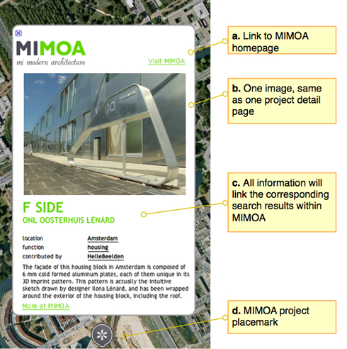
google kml place pages
not html
no plugins
or stylesheets
searchable?
http://www.mimoa.eu/blog/wp-content/picture-kmz.jpg

Slide 5
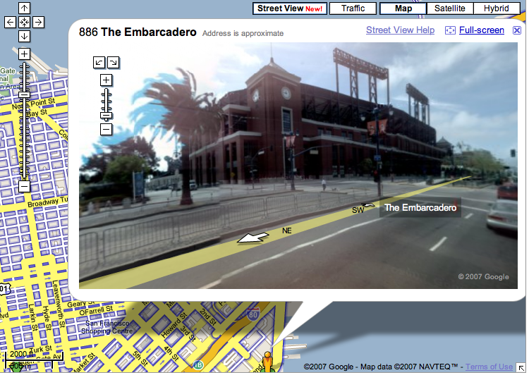
google KML focal plane markup
  <Point/PhotoOverlay >
    <coordinates>
      <lon,lat[,alt] >
    </coordinates>
  <distance>0</distance> <->
    <leftFov>0</leftFov> <->
    <rightFov>0</rightFov> <->
    <bottomFov>0</bottomFov> <->
    <topFov>0</topFov> <->
  </Point/PhotoOverlay>

Slide 6
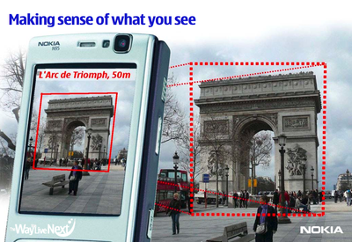
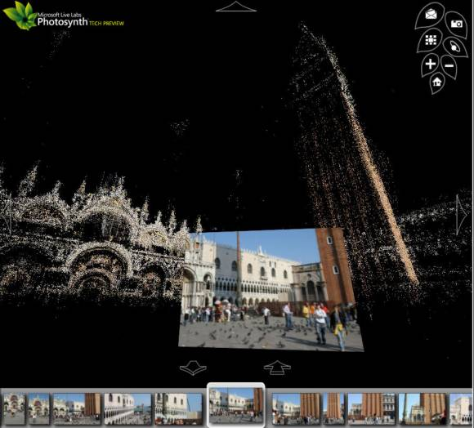
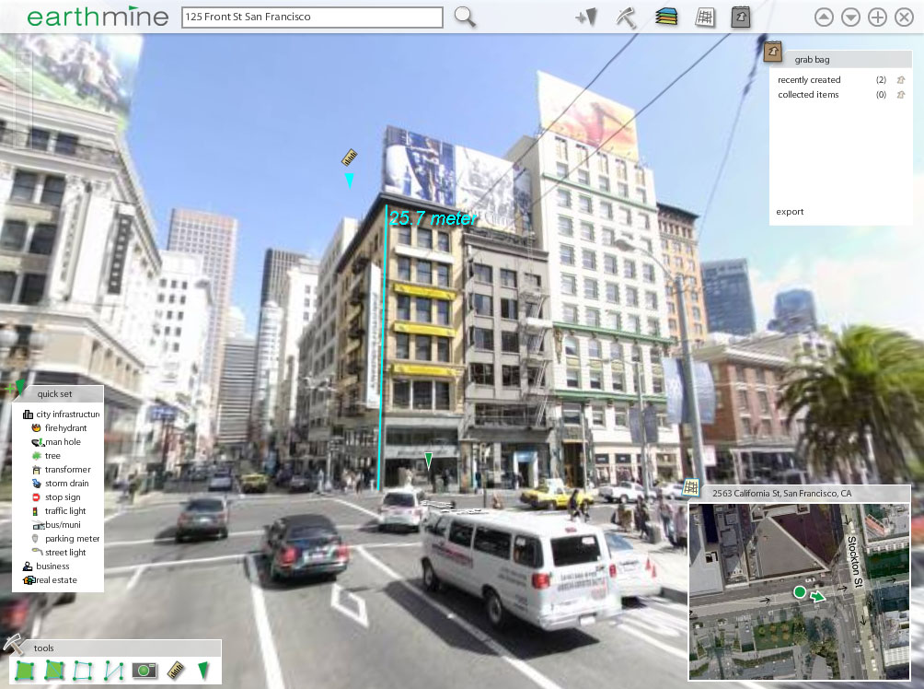
camera sensed and point cloud positioning
Nokia Point and Find
Photographic Geo-positioning
Microsoft Photosynth
Earthmine Precision 3D mapping
at 20cm/pixel accuracy
Notes:
Image sources
http://www.techcrunch.com/tag/earthmine/
http://meggangould.net/blog/mnt/w0605/d02/s02/a0002vtd/www/blog/wp-content/uploads/2007/09/photosynth.jpg
http://www.nokia.com

Slide 7
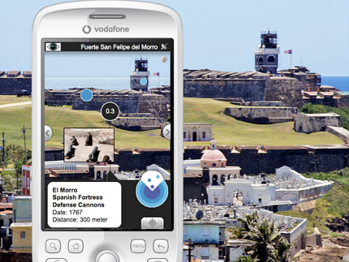
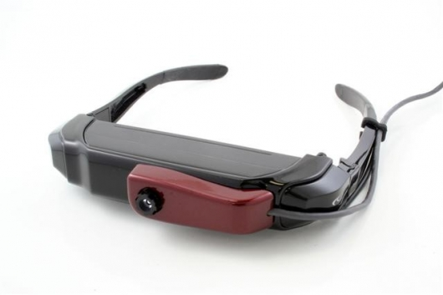
There’s time to do it right
AR today:
Handheld AR
Too awkward
Heads up AR
Too expensive

Slide 8
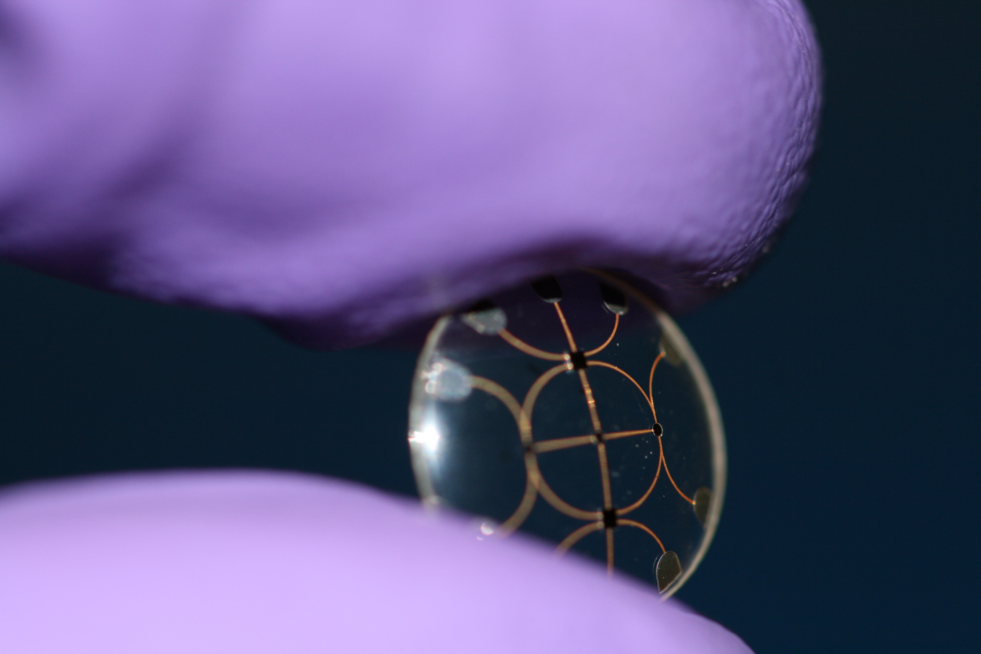
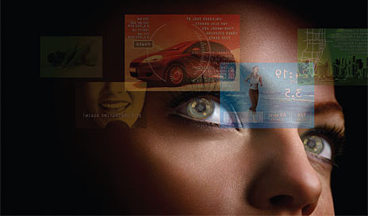
There’s time to do it right
AR tomorrow : Digital Contacts
Forecast:
useful, out of the labs 2018-2020
Researchers at the University of Washington have been developing a contact lens containing one built-in LED, powered wirelessly with radio frequency waves
http://www.wired.com/images_blogs/gadgetlab/2009/09/img_8791.jpg
http://spectrum.ieee.org/image/973128

Slide 9

Google Goggles
Shailesh Nalawadi
Product Manager, Google Goggles

Slide 10
What is Goggles?
People consume information visually, why not computers
Goggles is the first truly large scale mobile visual search application
Goggles is enabled by three computing trends
Powerful mobile devices
Cloud Computing
Pervasive Mobile Broadband

Slide 11
What's coming next in Goggles?
Expanding the corpus of recognized objects
Using search quality techniques to improve relevancy
Increasing the Goggles footprint
Enabling 3rd party developers to create interesting applications based on computer vision

Slide 12
Why we aren't ready to do AR
AR depends on accurate location & pose estimation. Current methods lead to an unsatisfactory user experience
Truly accurate location requires computer vision techniques
AR needs to move beyond a curated set of geo located content. The real world is much more dynamic content

Slide 14
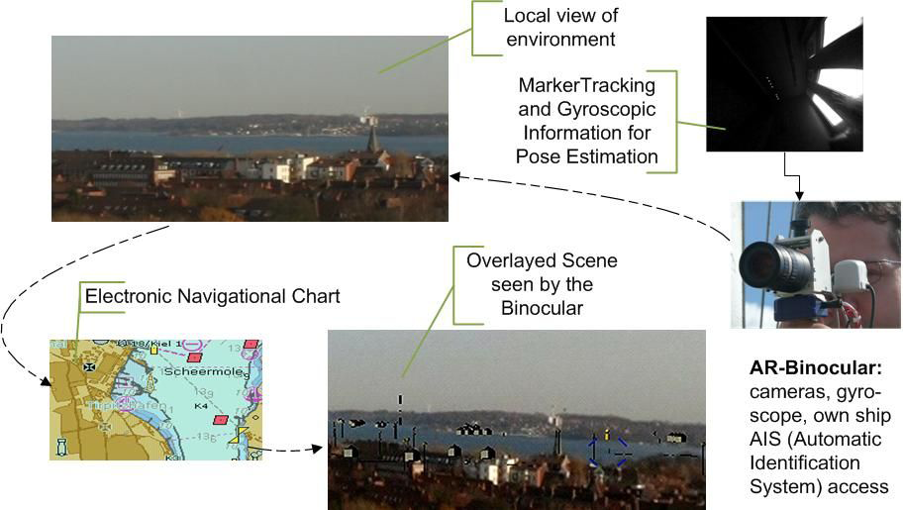
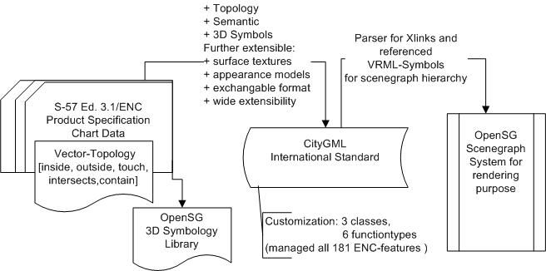
CityGML and AR search for "augmented reality" citygml
CityGML
  Application scheme of GML
  Structure for thematic modeling, semantic descriptions, appearance storage of 3D geometries and features
  Aligned with IFCs and BIM standards
Example: Extension of Electronic Nautical Charts for 3D interactive Visualization via CityGML. Haase and Koch, 2010

Slide 15
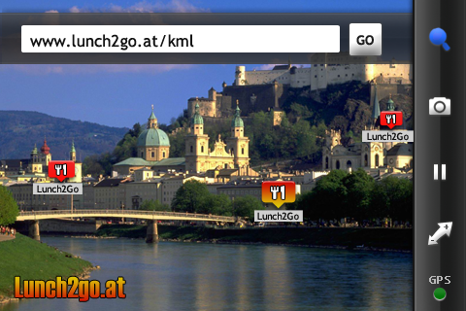
ARML and KML search "augmented reality" kml
ARML is an initiative to standardize the way points of interest are described and used in AR applications
Wikitude World Browser from Mobilizy is the first AR browser that natively supports ARML.
http://www.openarml.org/
© 2010 Open Geospatial Consortium, Inc.

Slide 16
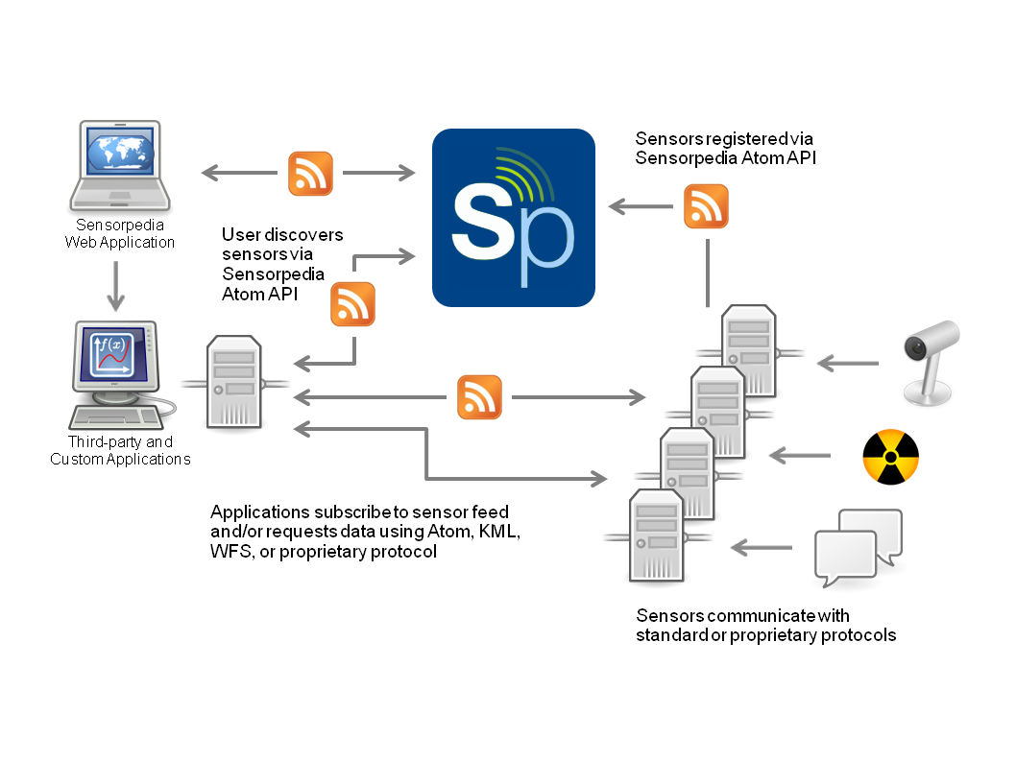
Sensorpedia http://www.sensorpedia.com/index.php
Sensors are a critical source of AR content
program initiated by Oak Ridge National Laboratory (ORNL) to utilize Web 2.0 social networking principles to organize and provide access to online sensor network data and related data sets.
OpenID
OGC Sensor Observation Service interface just added
© 2010 Open Geospatial Consortium, Inc.

Slide 17
    Truly Open Augmented Reality
    Where 2.0
    San Jose California
    March 31, 2010
  Damon Hernandez - Web 3D
©2010 Institute for the Future All rights reserved. All other brands and trademarks are the property of their respective owners. Reproduction prohibited without written permission.

Slide 18
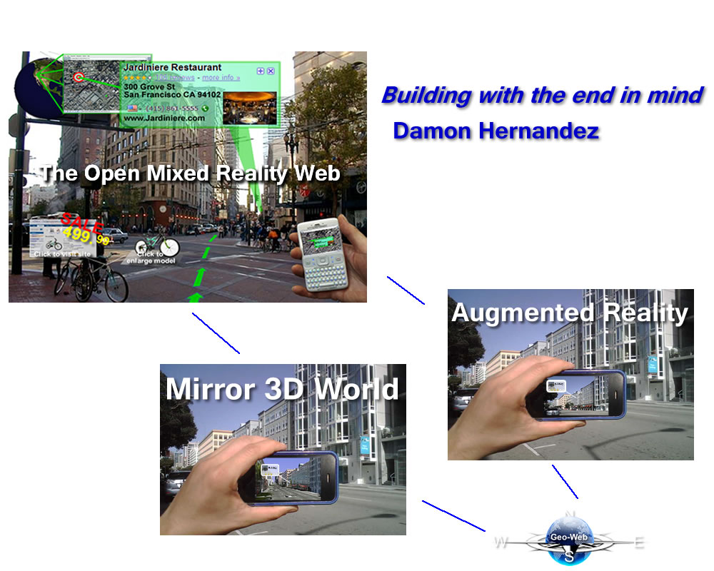

Slide 19
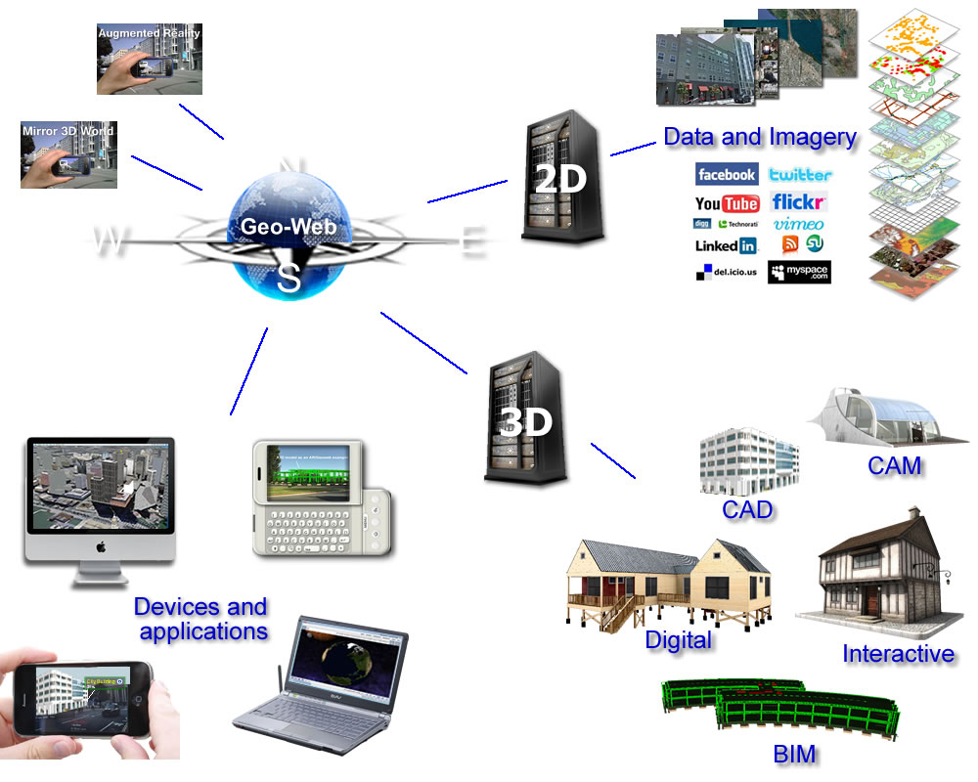

Slide 20
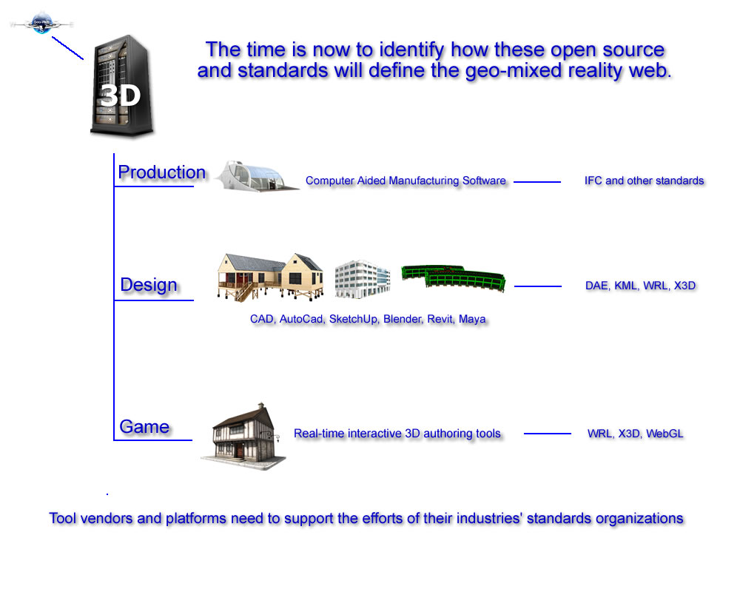

Slide 21
    Truly Open Augmented Reality
  Sophia Parafina – OpenGeo
      open data format(s)
      open protocol
      support for interaction
©2010 Institute for the Future All rights reserved. All other brands and trademarks are the property of their respective owners. Reproduction prohibited without written permission.

Slide 22
    Truly Open Augmented Reality
    Where 2.0
    San Jose California
    March 31, 2010
  Mike Liebhold – Institute for the Future
  Shailesh Nalawadi - Google
  Carl Reed - OGC Open Geospatial Consortium
  Damon Hernandez - Web 3D
  Sophia Parafina – OpenGeo
©2010 Institute for the Future All rights reserved. All other brands and trademarks are the property of their respective owners. Reproduction prohibited without written permission.

